Slide 1
Basic Trail Design
Welcome!
We’ll begin shortly after 5:30 PM

Slide 2
Zoom Technology Tips

Slide 3
Why are we here tonight?
Notes:
For curious trail workers who want to understand why so many trails are in bad shape because of how they were made. Learn how better design and layout makes trails more sustainable and less prone to erosion. Introduction to different trail design standards appropriate for different kinds of trails. This class is for anybody interested in these topics, but students with some trail building and maintenance experience will benefit the most.
First we will discuss Trail Planning, then Trail Layout, then Flagging.

Slide 4
The Planning Process
How does the planning process affect design?
Major and Minor Control Points in Trail Corridors
Reconnaissance
Designing for Capacity, Aesthetics, Safety
Resource Specialists

Slide 5
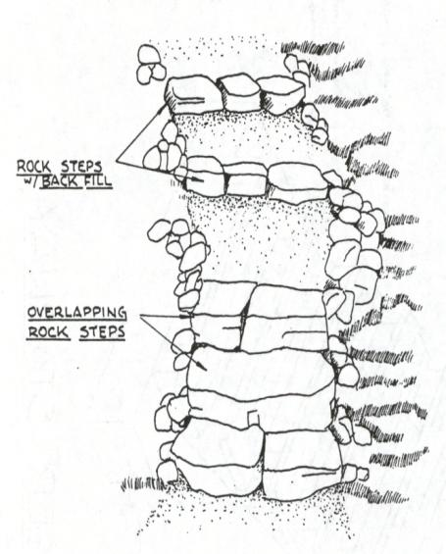
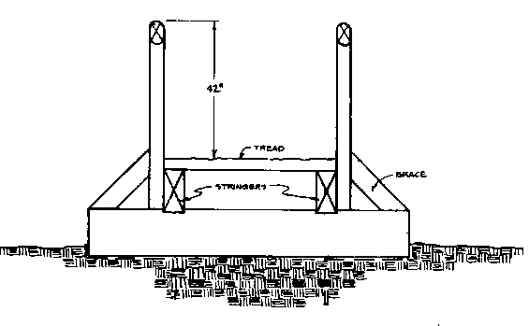
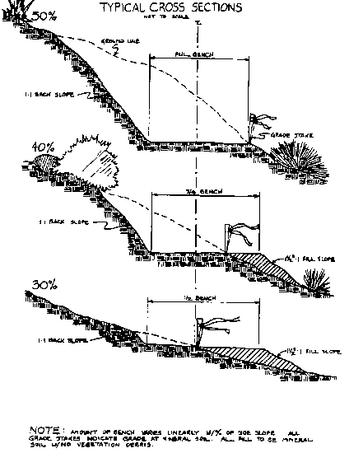
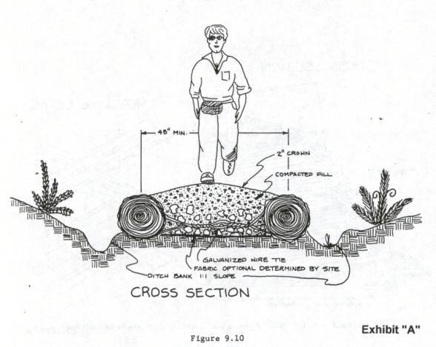
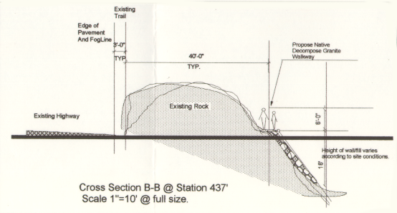
Determine Specifications & Standards – Based on User Group, Classification and Season of Use
Notes:
The land management agency (eg, USFS) has sets of trail standards based on user type, trail class, and season of use. These may vary regionally. Make sure to consult with your local unit on the right set of standards for your trail.
Discuss the usefulness of a trail classification system for planning trail maintenance and providing different trail experiences.

Slide 6
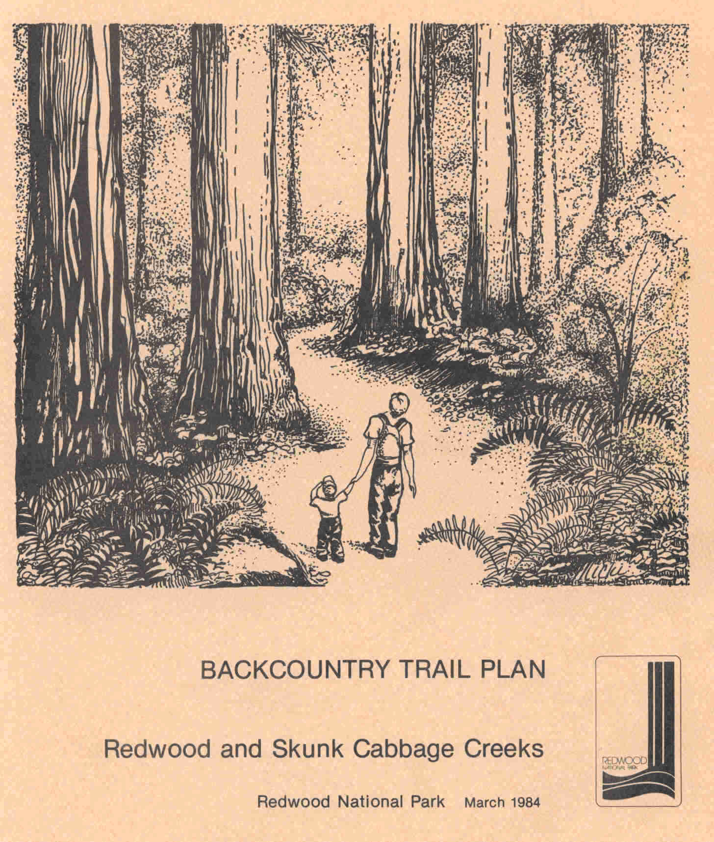
Land Unit Trail Plan
Notes:
Trail planners need to research whether the area they have in mind for the trail already has land management plans in place, for example, plans pertaining to recreation, wildlife, forestry. . .

Slide 7
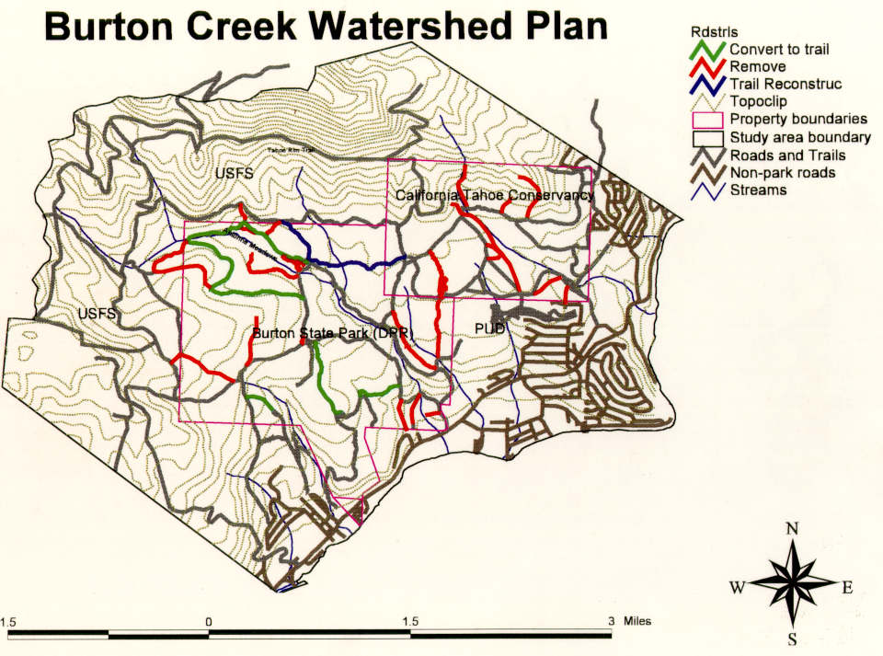
Notes:
or watersheds. Additionally, some pieces of Federal land have special Congressional designations such as Wilderness Area, Wild and Scenic River, or National Scenic Trail. Such lands, including the Pacific Crest National Scenic Trail, have special management plans that further guide trail planning and design.

Slide 8
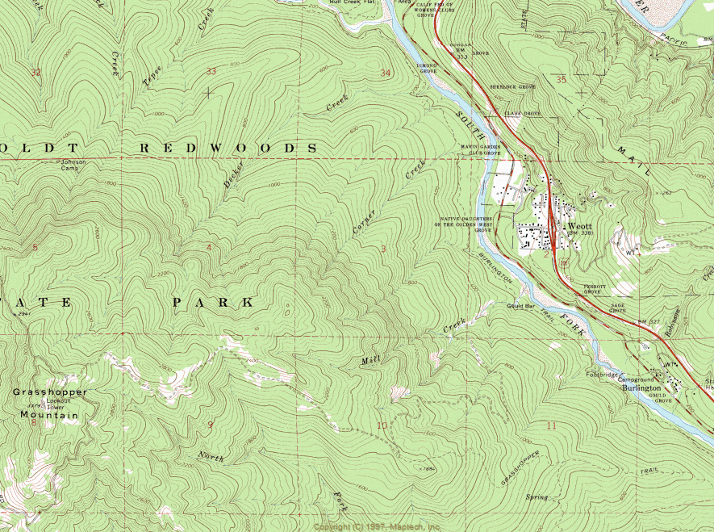
Topographic Maps
Topographic Maps
Notes:
The next step in Trail Planning is to obtain a detailed Topographic Map of the area. (Show students briefly how to read contour lines: eg, lines closer together means steeper hillside, etc).

Slide 9
Identify Control Points
Control Points are areas that the trail corridor NEEDS to pass by (positive), or avoid (negative).
Major control points should be identified BEFORE on-the-ground reconnaissance.

Slide 11
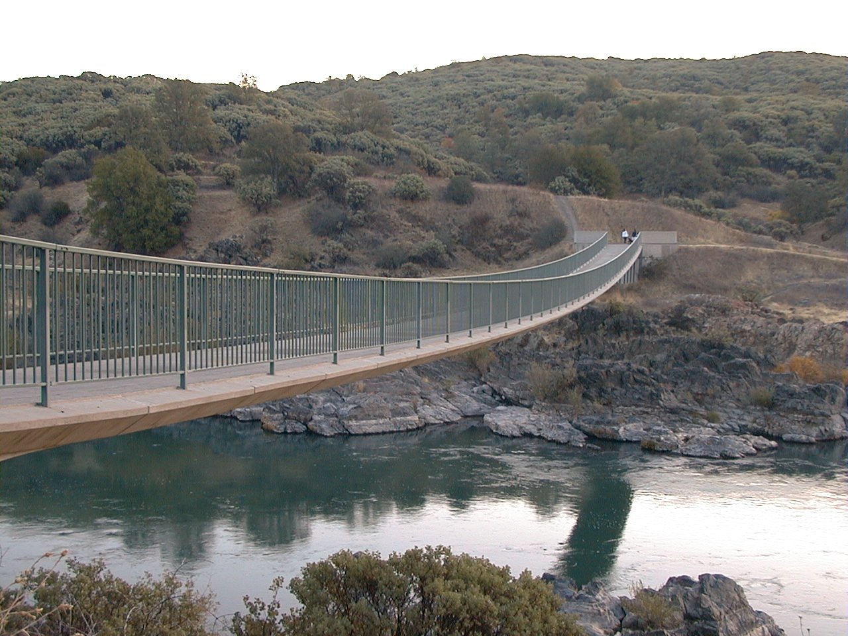
Rivers or Bodies of Water
Major Control Points
Notes:
Positive control points are highly desirable places by which they want the trail to pass. Examples include a trailhead location with adequate parking, stream crossings for affordable bridges (narrow and high-banked) or safe fords (shallow and firm), scenic viewpoints, and side-hill terrain with durable soils on which to build a sustainable trail.

Slide 12
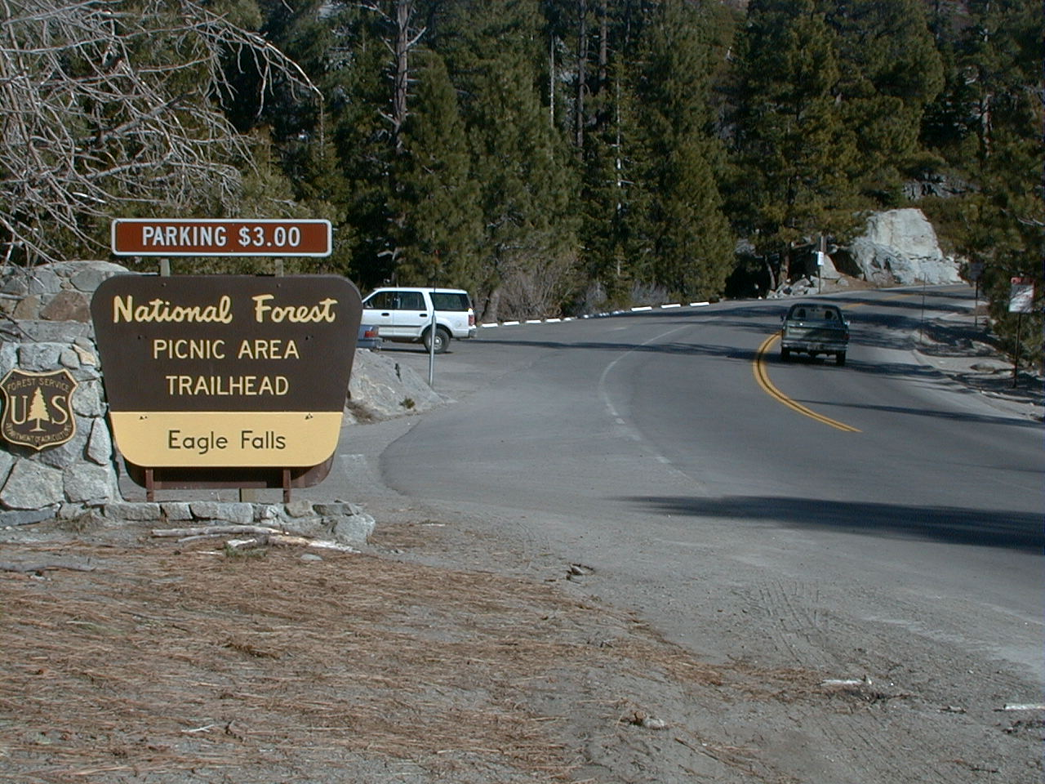
Major Road or Highway Crossings

Slide 13
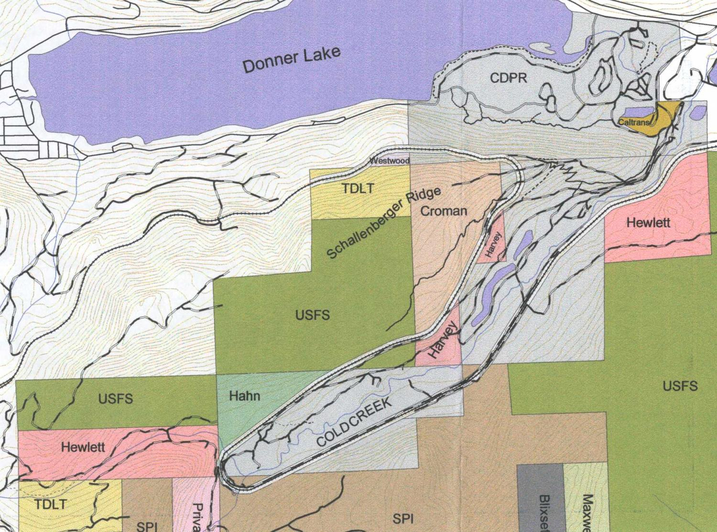
Property Boundaries, In-holdings, Easements

Slide 14
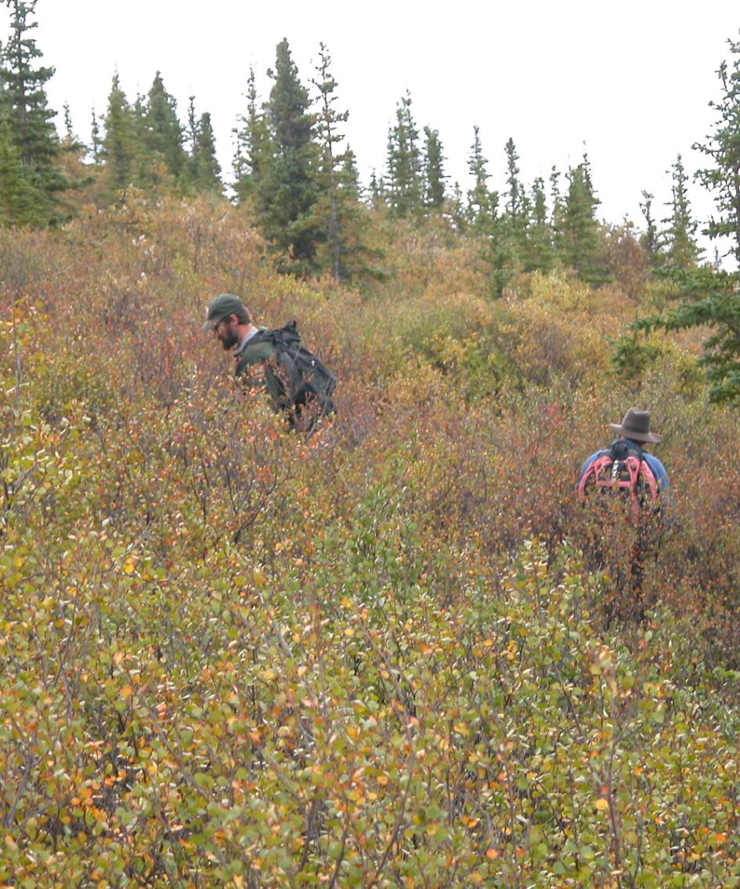
Reconnaissance
Walk the trail corridor, from one major control point to another.
Identify minor control points!
Notes:
Now that you’ve identified a very rough trail corridor based on researching land management plans, maps, and photos, it’s time to get out on the ground and check it out.

Slide 15
Minor Control Points
Features in the trail corridor that will influence the alignment of the trail.
Typically discovered (and worked around) during on-the-ground reconnaissance.
Notes:
During reconnaissance, designers establish minor control points. These may cause minor shifts in the trail alignment, but won’t change the overall route. Examples to follow. . .

Slide 16
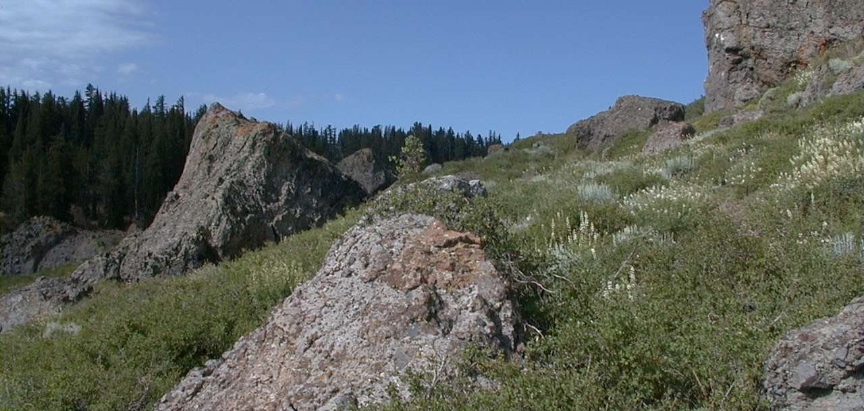
Rock Outcrops
Notes:
Examples include rock outcrops, springs/seeps, big trees, and rock slides/debris flows. Designers keep track of rough grades between control points with a clinometer. Reconnaissance also allows designers to determine an alignment that highlights the natural aesthetics of the area.

Slide 17
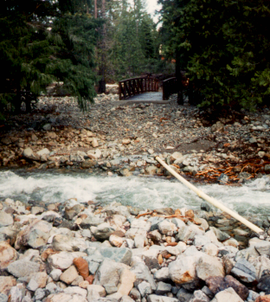
Stream Crossings
What’s wrong with this picture?
What should be taken into consideration when designing a stream crossing?
Notes:
What’s wrong with this picture? The stream moved!

Slide 18
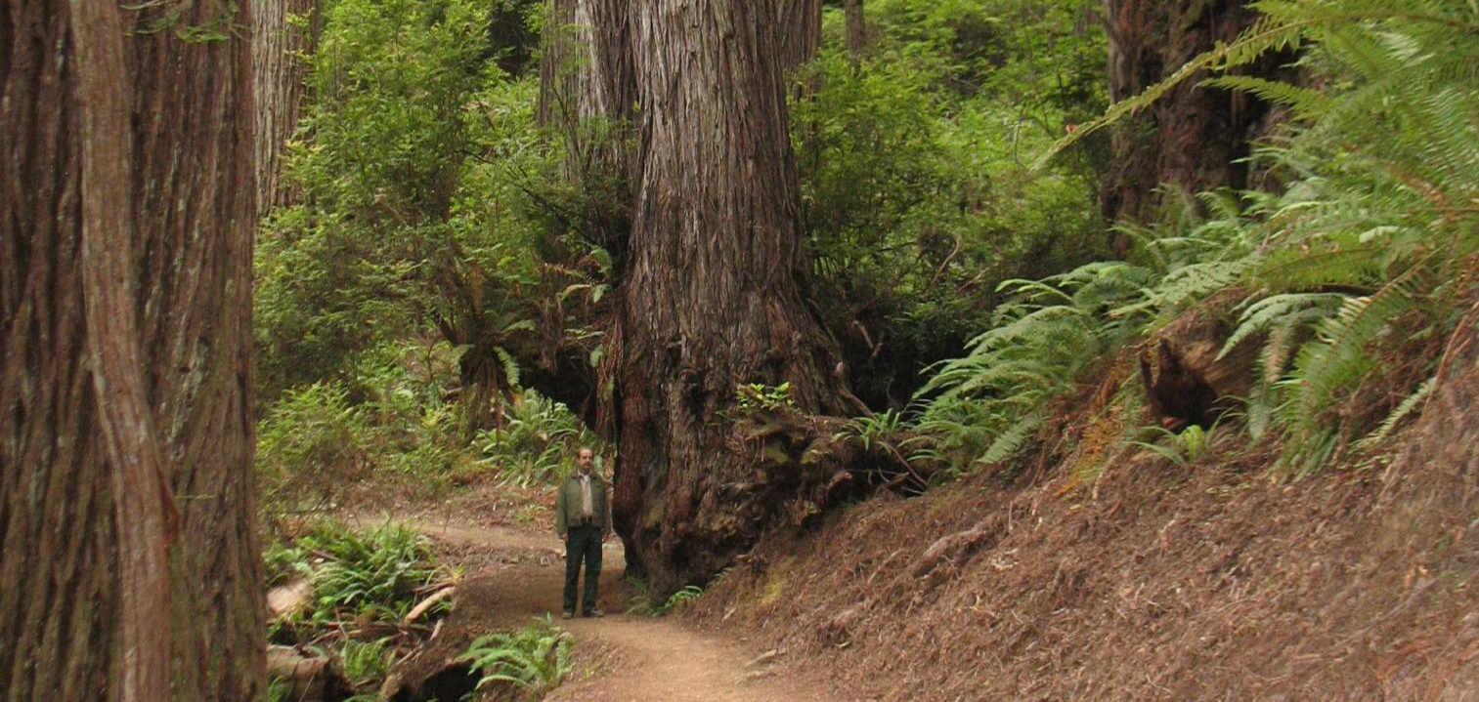
Large Trees
10’
Notes:
Notice how much the trail grade would be affected if it were aligned over top of the tree. To produce the most graceful and sustainable tread alignment, decisions about which way to go around minor controls need to be considered before flagging begins.

Slide 19
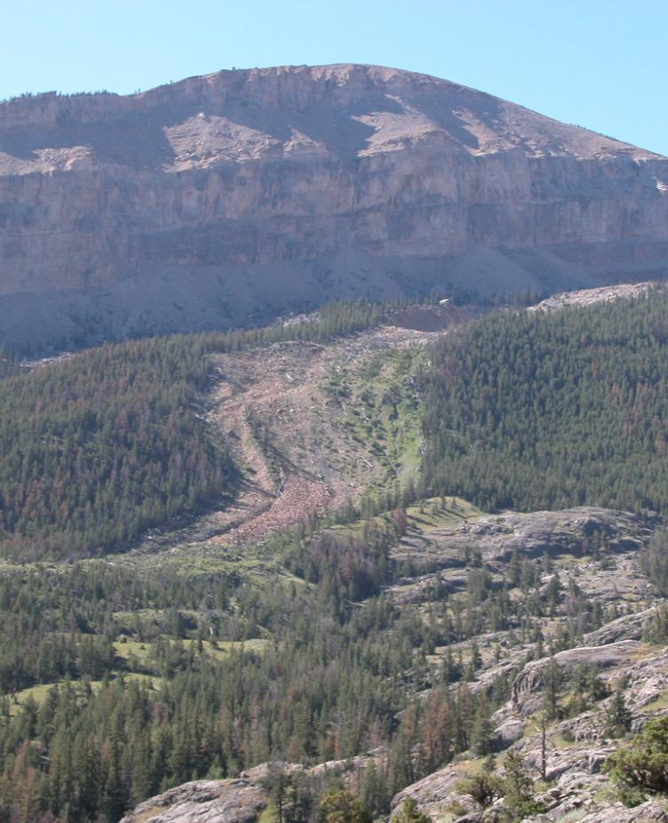
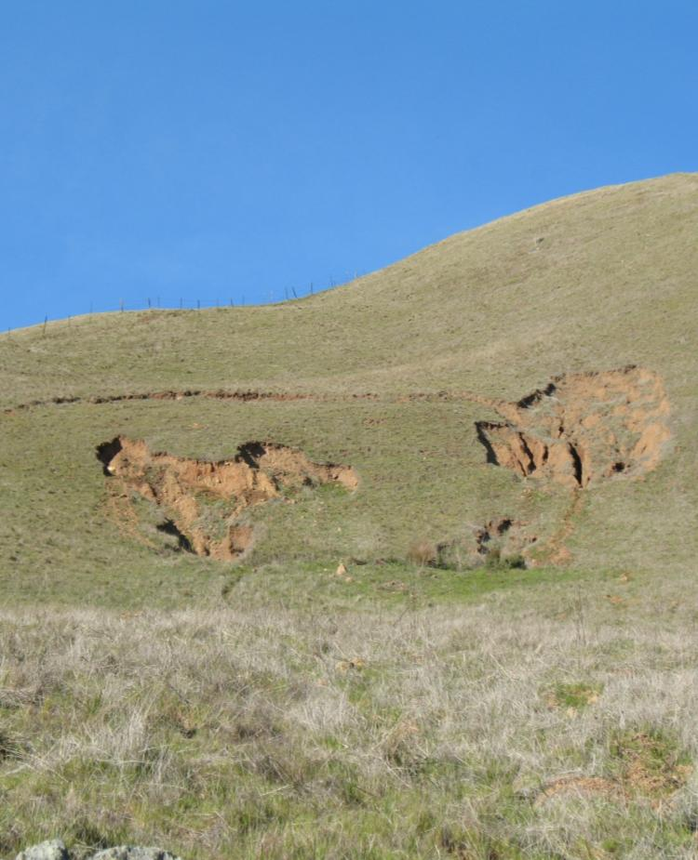
Debris Flows
Notes:
Won’t show up on topo maps!

Slide 20
Land Capability: Soils
Sustainability of trail depends on grade (steepness) and soil type
From Least to Most Durable:
Sand
Silt
Loam
Clay
Gravel
Shale/Scree
Notes:
Reconnaissance is also the time for careful assessment of land capabilities. Soil type and vegetation are clues as to whether or not the terrain is suitable for a trail. Best are durable soils on hillsides that can sustain a full bench with good outslope (more on these topics below). A varied matrix of good material, (eg, clay-sand, and angular gravel), will compact and keep soil moisture content, sustaining steeper grades and heavier use. Soils are almost never purely one of these, but a mix.

Slide 21
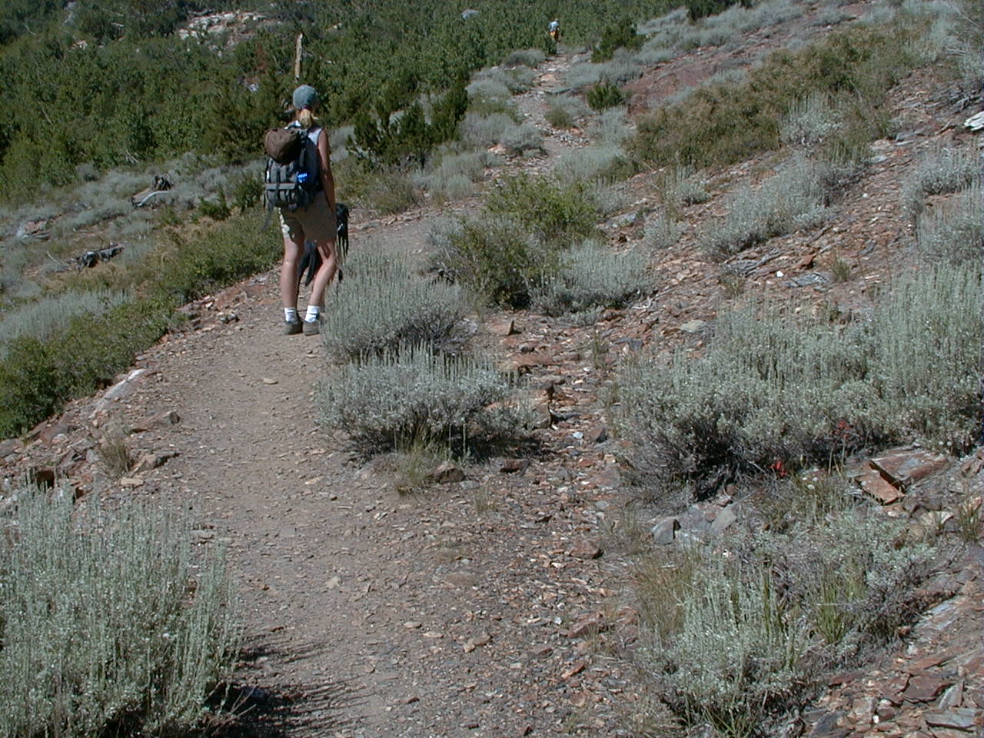
A good material matrix will compact and keep soil moisture. This will help the trail sustain steeper grades and heavy use.
Notes:
A mix of soils with various particle sizes and a bit of fine binder material (eg, clay), produces a durable tread surface.
During reconnaissance, aim to align your corridor upon the most durable surfaces.

Slide 22
Resource Specialists
National Environmental Policy Act (NEPA)
Hydrologist Review of Stream Crossings
Archaeological Cultural Survey
Consultation & Surveys on Sensitive, Threatened, and Endangered Wildlife Species and Plants.
Notes:
Then it is time to call in resource specialists for their on-the-ground surveys. A trail that is to be built on any Federal land must follow guidelines of the National Environmental Policy Act (NEPA) to be sure that trail construction and use do minimal damage to fragile ecological, historical, or archeological resources. This involves the analysis by a variety of specialists, including botanists, wildlife and fisheries biologists, and archeologists, among others. If the specialists reveal sensitive areas that a trail could disrupt, designers then consider these major control points, and reassess the proposed route.

Slide 23
Break!
& Giveaways?

Slide 24
Trail Layout
Notes:
Final steps!
Understand Hydrologic Influences of trail alignments, determine the maximum sustainable linear grade, measure the linear grades between control points, and flag the trail alignment.

Slide 25
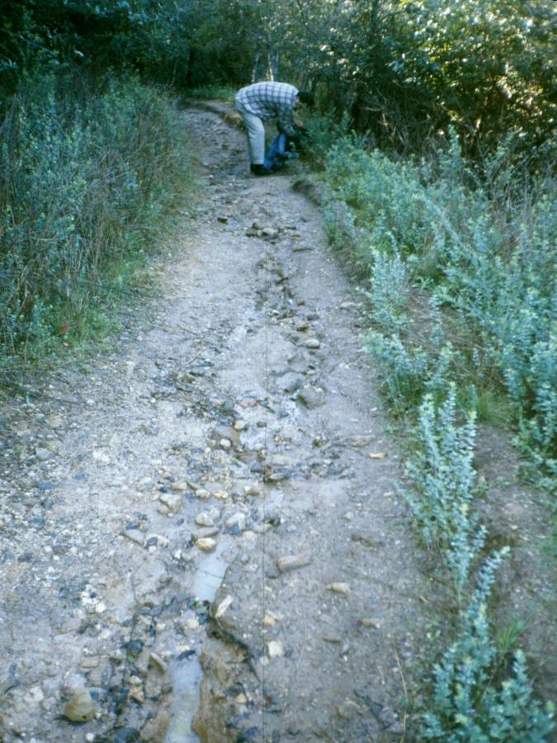
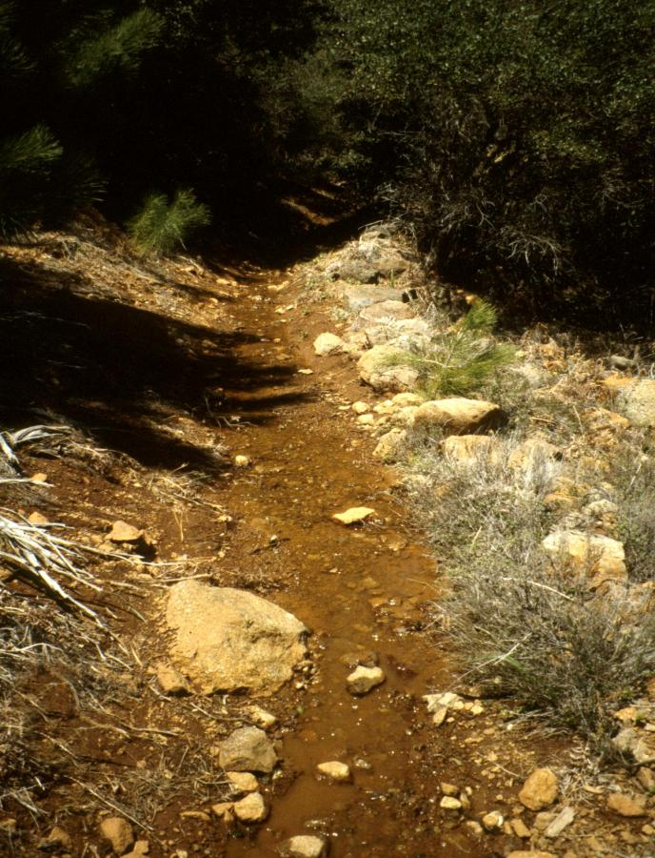
Water is the Most Influential Factor in Designing and Laying Out Trails
Notes:
What is happening on these trails? Water is flowing down the middle of the trail, causing erosion and disrupting the natural hydrological pattern of the hillside. This is what you do not want.

Slide 26
Sidehill Tread
Notes:
Ideal sidehill tread is outsloped, and has no slough or berm. In the last slide, if the berm were removed and the outslope restored, water would not have diverted onto the trail.

Slide 27
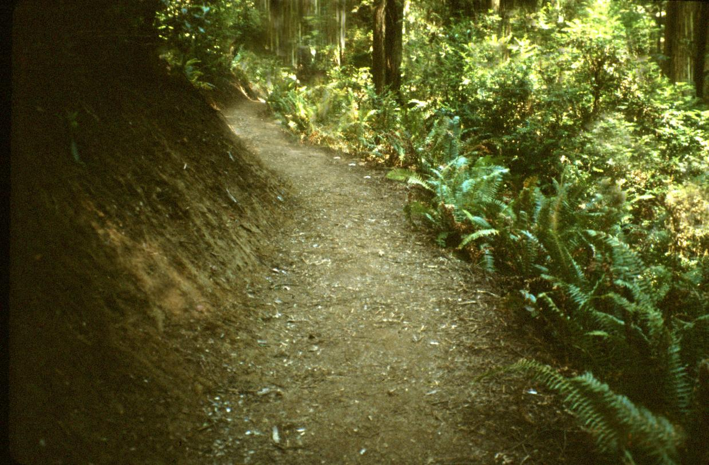
Sidehill Construction and Outsloping Prevents Water Diversion and Accumulation

Slide 28
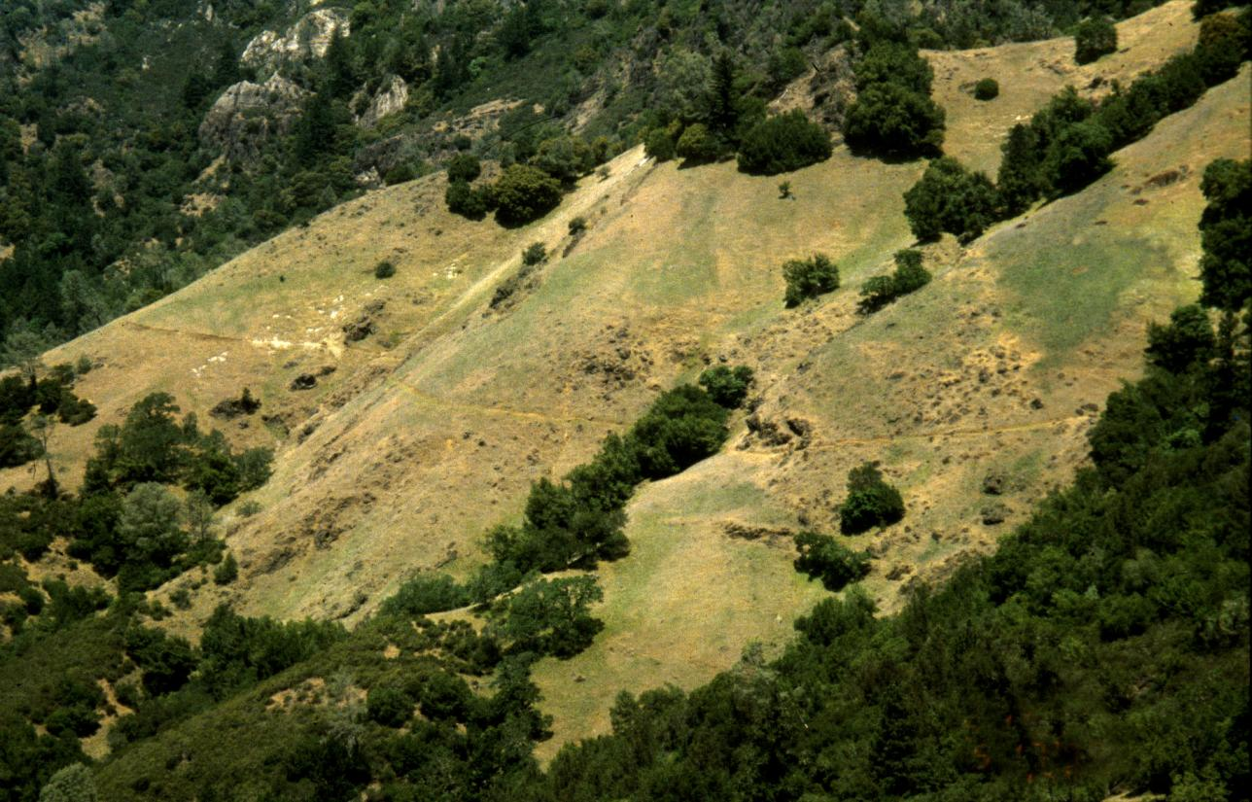
Curvilinear Alignment (Opposite of Fall Line) Makes the Trail Basically Perpendicular to Natural Sheet Runoff
Notes:
In a perfect trail world, water from rain, melting snow, and seeps, sheet flows down a hillside and encounters a trail with good outslope and no berm-- it gently crosses the trail and continues down the hillside without causing any erosion of the trail tread.
Water naturally goes down the fall line. The Fall line is the fastest way down the hill. If a trail goes straight up the fall line, there is no way to drain the water off of it.

Slide 29
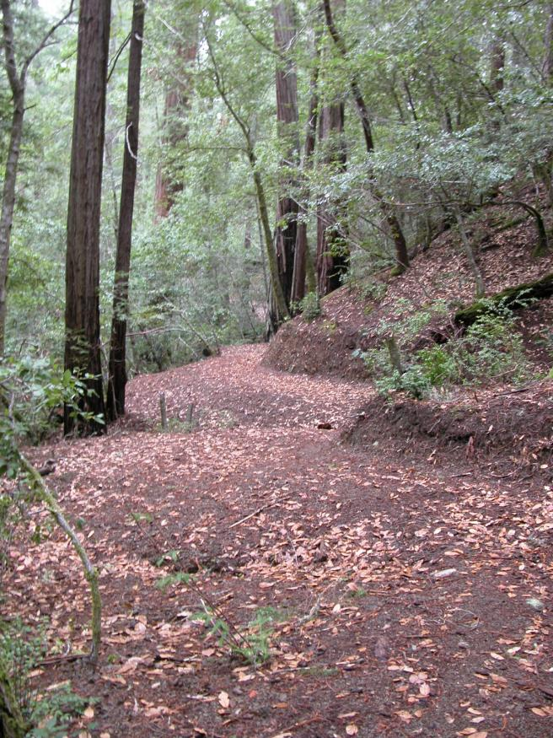
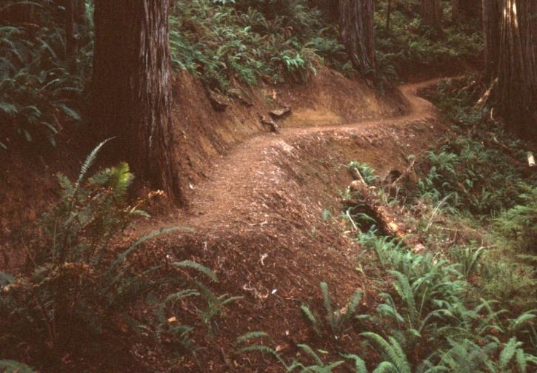
Curvilinear Layout Requires Closely Following the Landform/Hillside

Slide 30
Vegetation and wildlife communities below are affected by changing the amount of water they receive
Notes:
We build trails to take us out into landscapes we want to enjoy in their natural state. But if our trails are changing the landscape’s hydrological patterns, we are impacting that landscape. Therefore, we need to ensure our trails are designed well and continue to drain properly– it is a Leave No Trace practice!
The best way to protect trails from typical erosion patterns is by good trail design and construction, whereby a new trail has curvilinear alignment and modest grades (less than 10-15%). Such a trail should pass only through durable soils on hillsides that can sustain a well-compacted full bench and generous outslope. This facilitates sheet flow and minimizes the need for drainage structures.

Slide 31
Grade Reversals must be designed in natural drainages in order to prevent water diversion onto the trail
Notes:
This picture shows how water descending a natural drainage (aka draw, swale) can get diverted onto a trail. This could have been prevented with a grade reversal.

Slide 32
The trail should go uphill in both directions out of a natural drainage

Slide 33
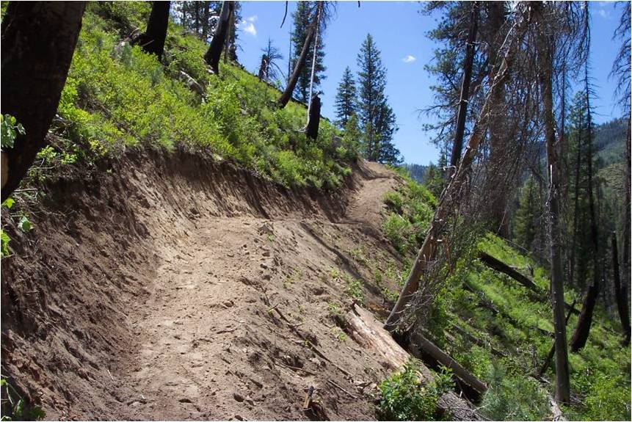
Grade Reversals are Sometimes Incorporated Even in the Absence of a Natural Drainage Crossing
Notes:
Grade reversals are especially important wherever the trail passes through a natural drainage. However, as extra insurance, many designers incorporate frequent grade reversals even when the hillside is uniform, without apparent natural drainages. This is particularly pertinent under more erosive soil conditions, when the tread may not hold its outslope very well. “Pointless Up and Downs”

Slide 34
Other Considerations

Slide 35
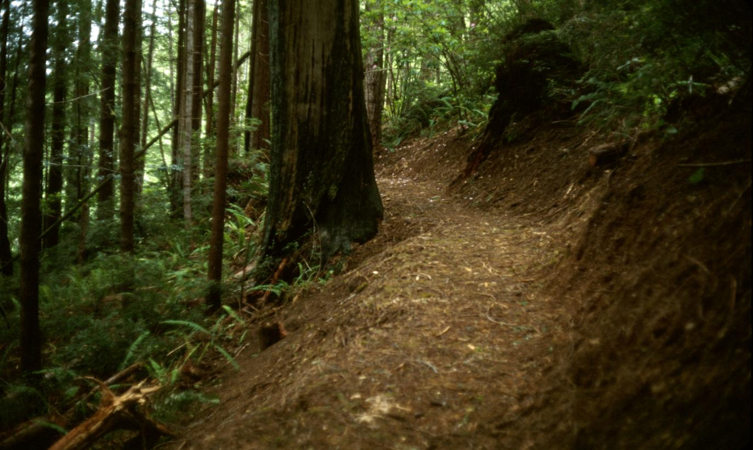
When possible, align trail above trees

Slide 36
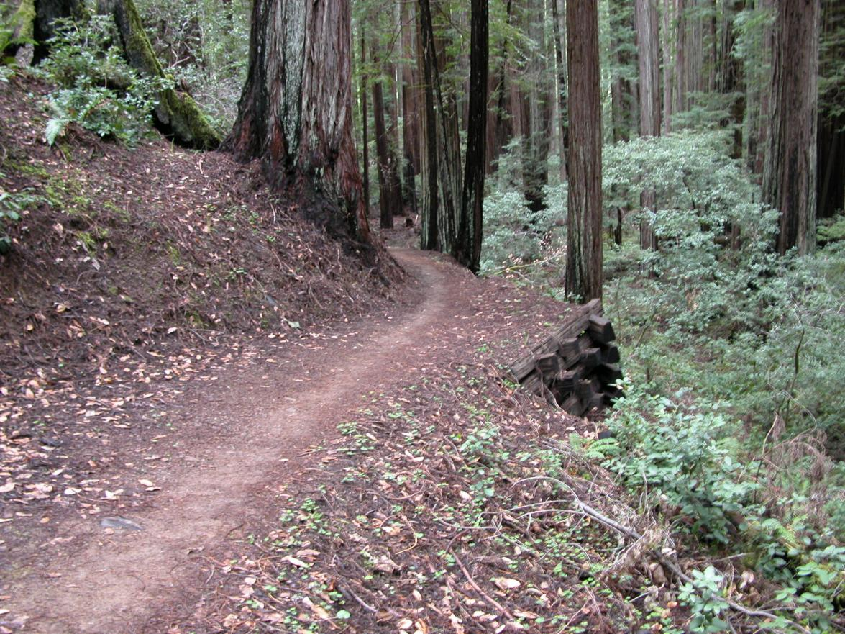
Retaining Walls are often required when the trail passes under a large tree:
Notes:
Without a retaining wall, trail builders would be cutting into the tree’s roots.

Slide 37
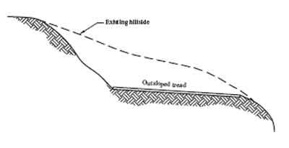
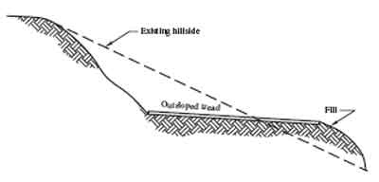
Full Bench
Partial Bench
Notes:
Full bench construction means the entire tread surface rests on undisturbed native soil. Part bench means part of the tread surface is fill. Part bench is not recommended. The fill almost never becomes sturdy.

Slide 38
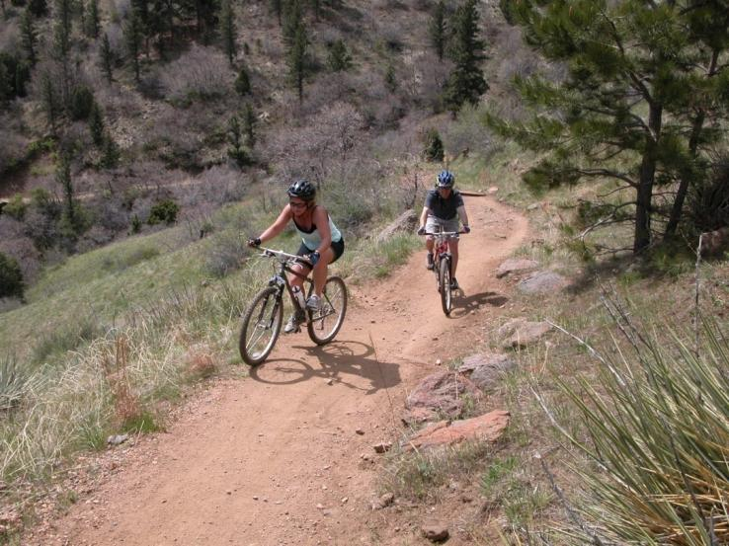
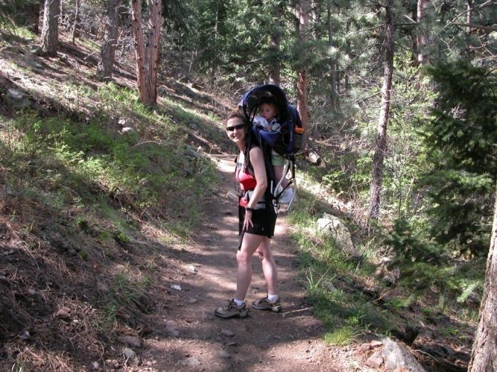
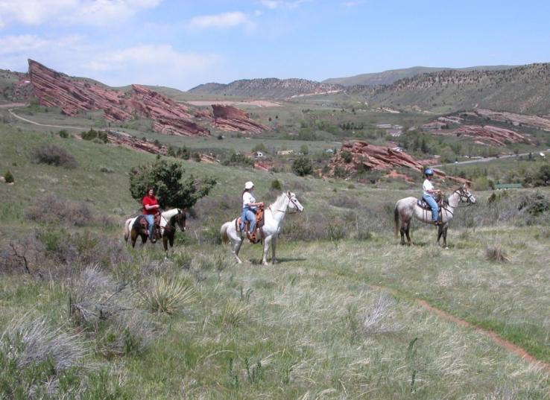
User Groups

Slide 39
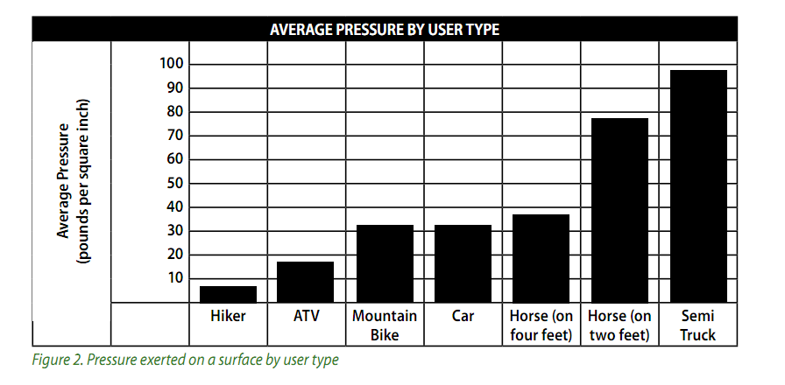
Source: Equestrian Trail Guidelines for Construction and Maintenance, published by the Conservation Commission of the State of Missouri
Notes:
Each user type exerts a different kind of pressure and a different kind of wear upon a tread surface. It is important that trails are built with the right surface material and grade to withstand the user type for which they are intended.

Slide 40
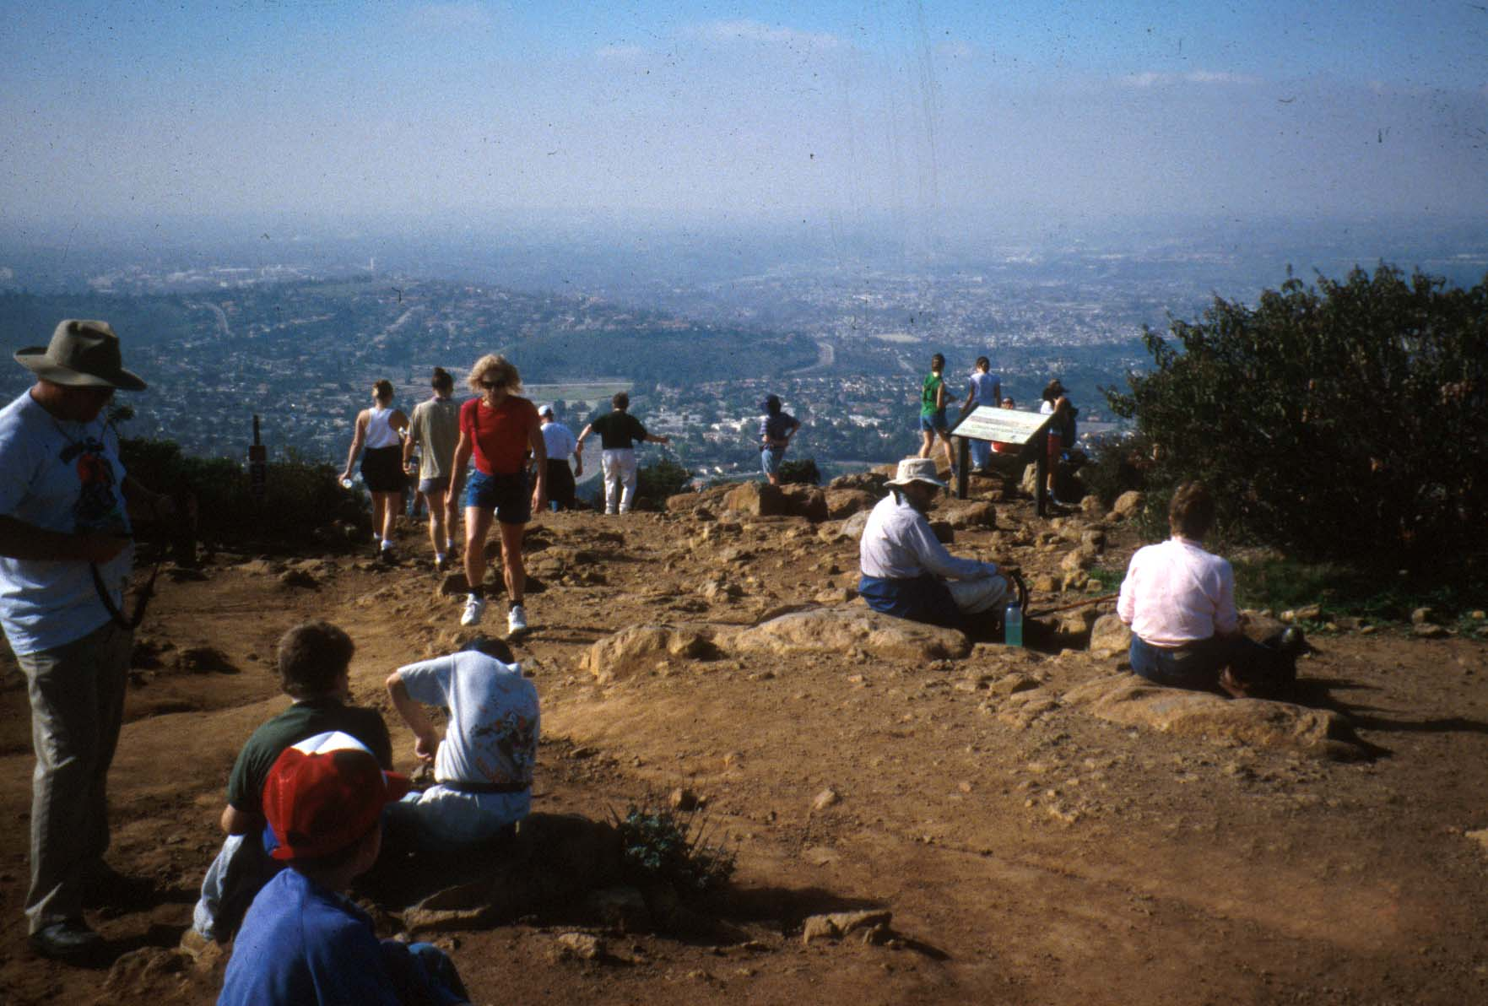
Level of Use
Notes:
Heavier use usually means more erosion, therefore you’d want a gentler grade.

Slide 41
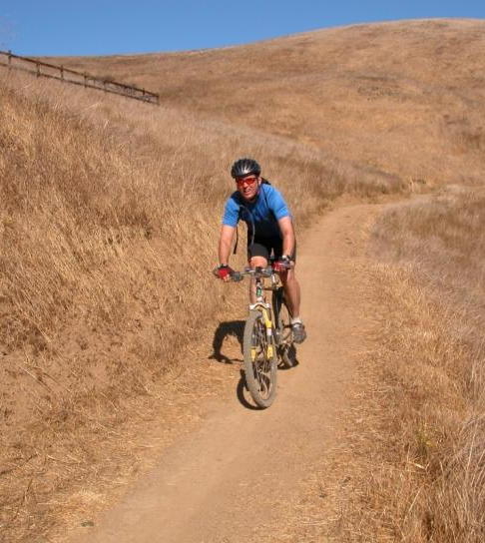
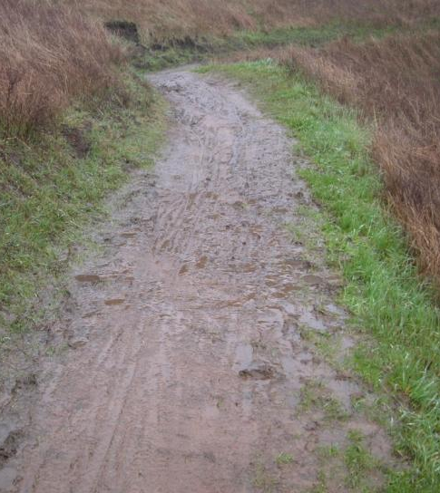
Season of Use
Notes:
This trail can withstand summer traffic much more than winter. If it is meant for winter use, consider making the grade more gentle. What about annual rainfall?

Slide 42
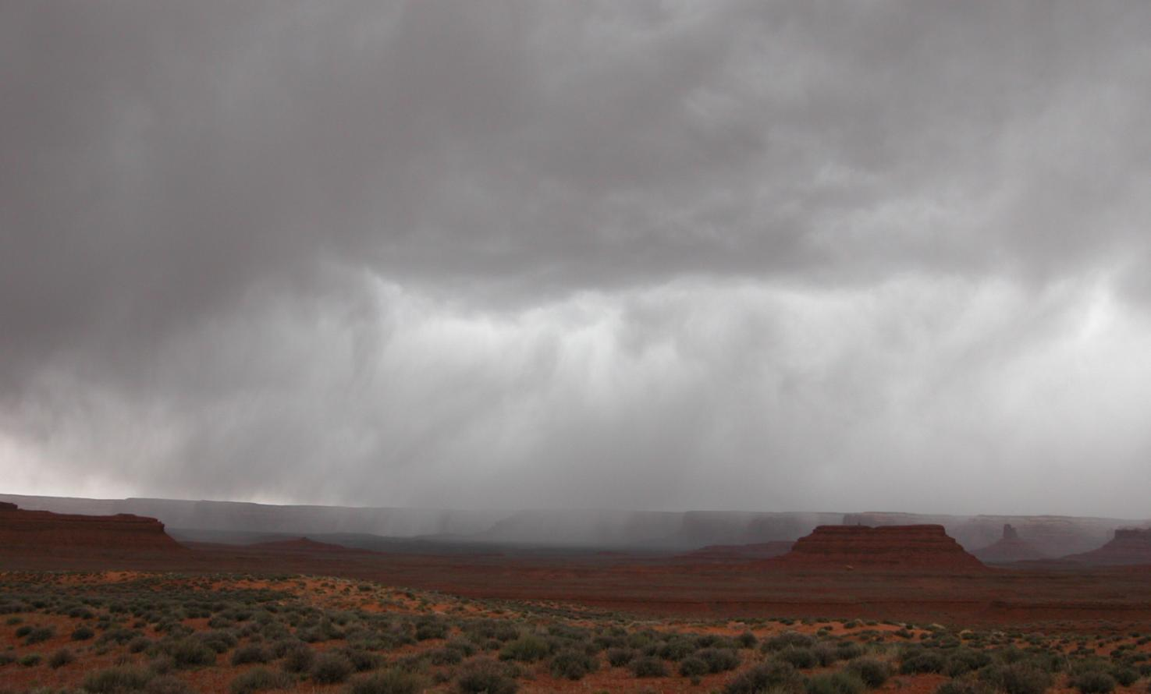
Rainfall Intensity
Notes:
Also in this category would be rapid snowmelt. If a trail needs to withstand a lot of water all at once, that will affect what you deem to be the maximum grade.

Slide 43
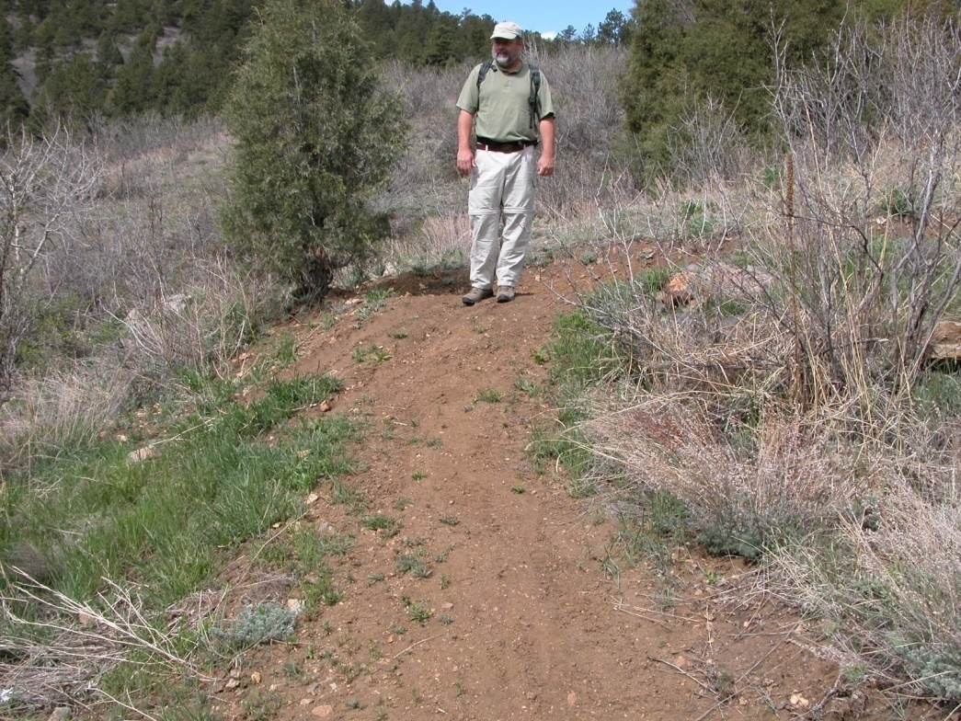
Evaluate Existing Trails in the Area: Observe what Grade(s) are Sustainable
Notes:
If possible, a designer should assess similar trails in the nearby area and observe what grades are sustainable there.
Based on all these factors and observations, a designer should determine the maximum sustainable grade for the new trail.

Slide 44
Establishing a Grade
1,000 ft. elevation gain over 10,000 ft. of run
Notes:
After you’ve established the maximum sustainable grade, go back to your map and look at the average grade between major control points.

Slide 45
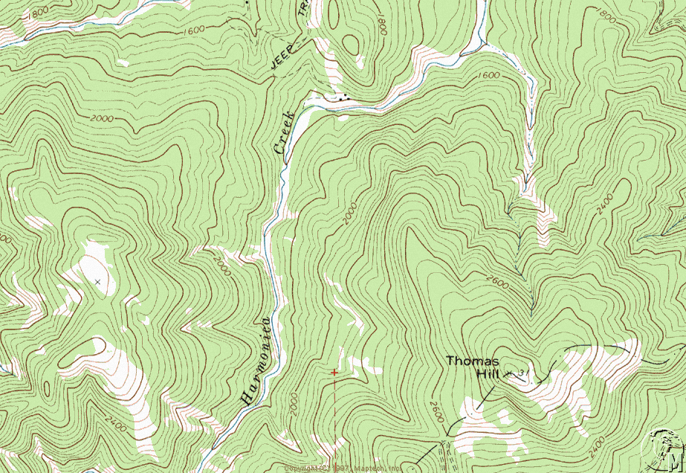
Calculate your grade between control points
10%
8%
7%
7%
9%
6%
Notes:
This way you can avoid abrupt grade changes. Flagging From two Control Points Back Towards the Center is an Effective Method

Slide 46
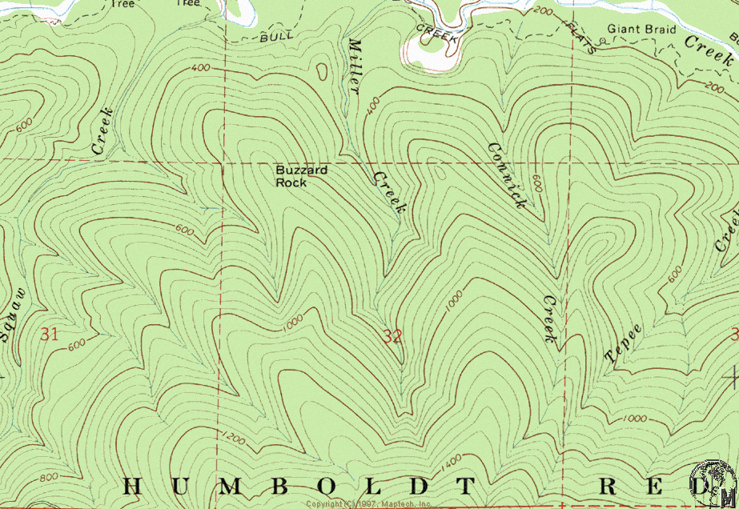
If the average linear grade exceeds the prescribed grade additional linear run may be required
Notes:
If the grade between two points exceeds maximum, a designer needs to add run (distance) with well-placed turns. Topographical turns are preferable to switchbacks or climbing turns, because they are less detectable, and therefore less prone to cutting.

Slide 47
Topographical Turn:
Notes:
If switchbacks or climbing turns are necessary, each one should be located very deliberately. Locate to facilitate drainage away from the corner by using a ridge nose or a natural topographical swale/drainage.

Slide 48
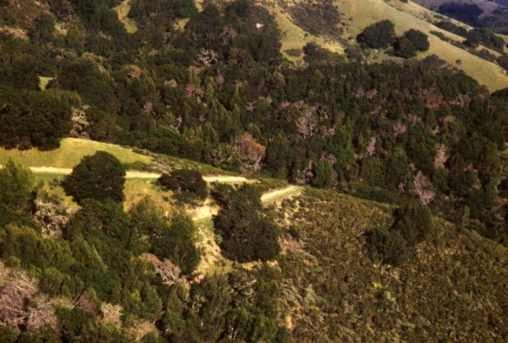
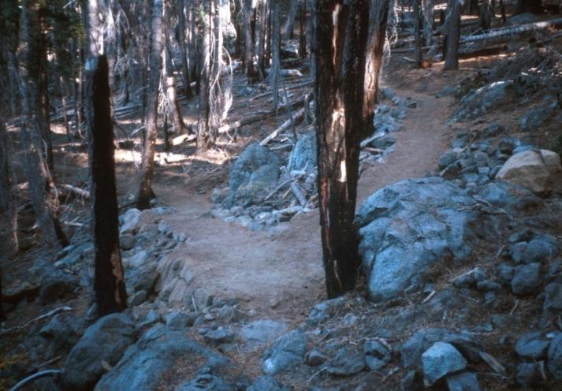
If a Topographic Turn Is Not Available Then a Climbing Turn or Switchback Can Be Used to Gain Linear Run
<30%
>30%

Slide 49
Final Step: Flagging

Slide 50
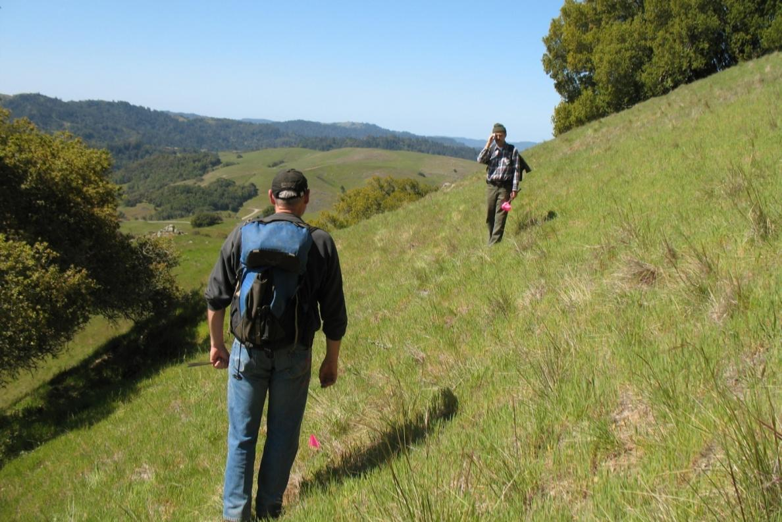
With a Two Person Team The Shooter takes the Front Position so the Shooter Can See the Upcoming Terrain

Slide 51
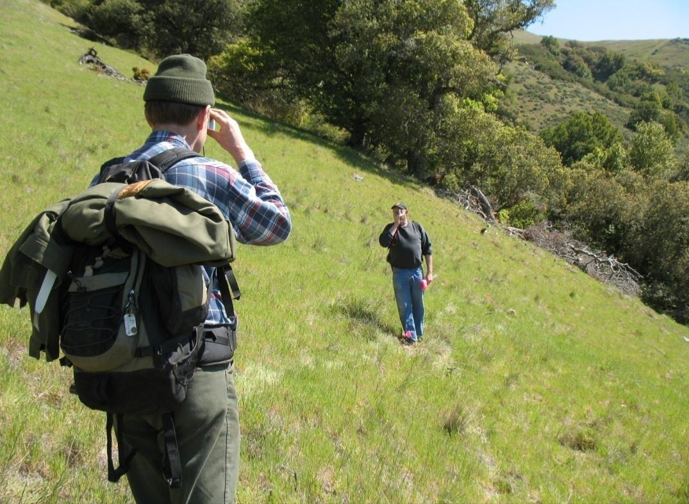
The Shooter Locates Their Reference Point on their Partner and Moves up or Down Slope to the Prescribed Grade

Slide 52
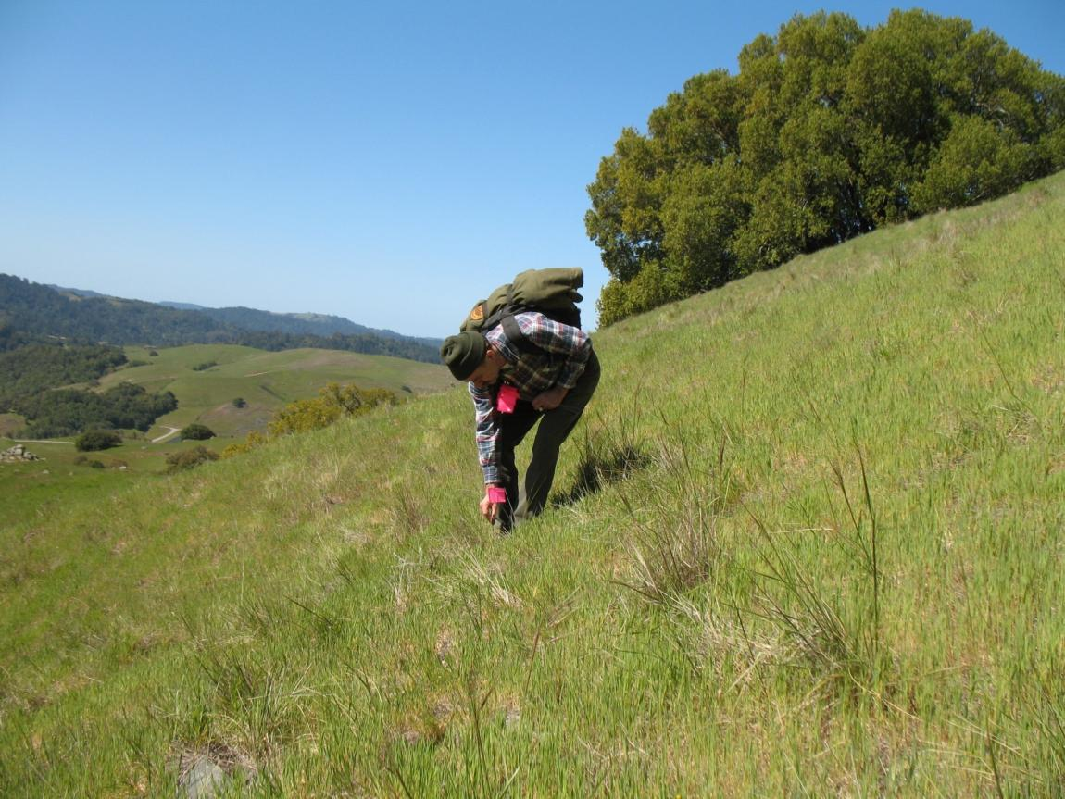
The Shooter Then Places a Flag Marking Trail Grade

Slide 53
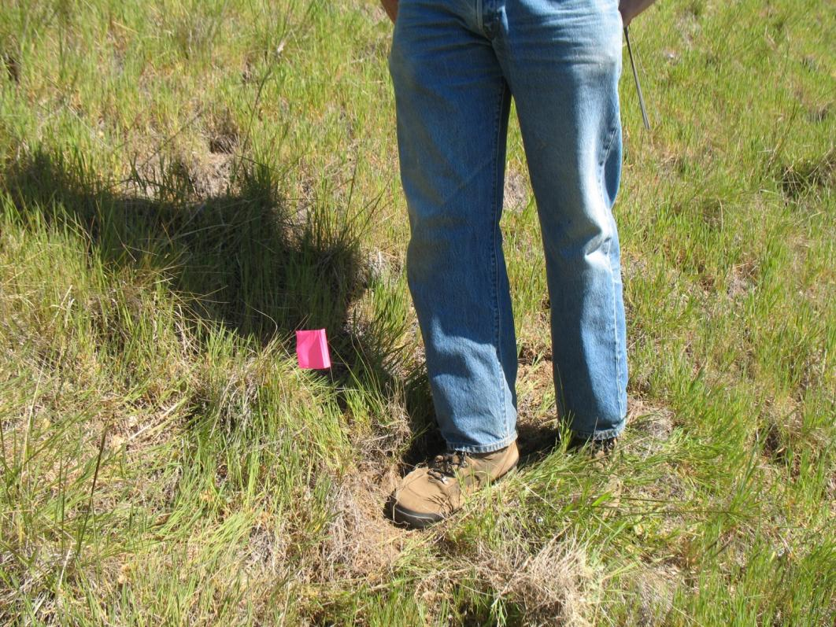
The Shooter Moves Forward for the Next Shot and the Partner Moves to Where the Shooter Previously Stood

Slide 54
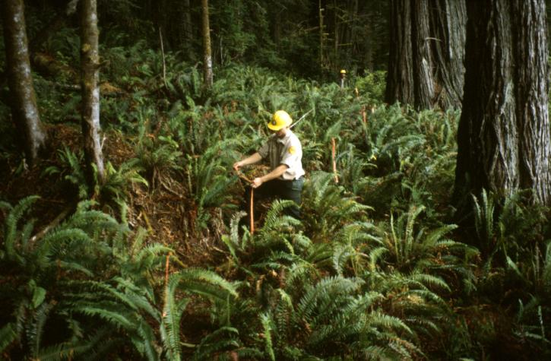
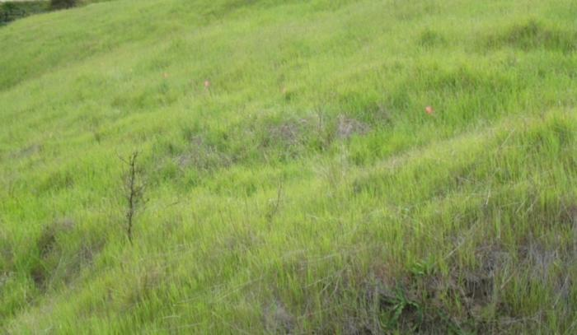
The Initial Flag Line Should Be Loose Flagged. Tight Flagging Is Performed Once the Loose Flagging Is Completed

Slide 55
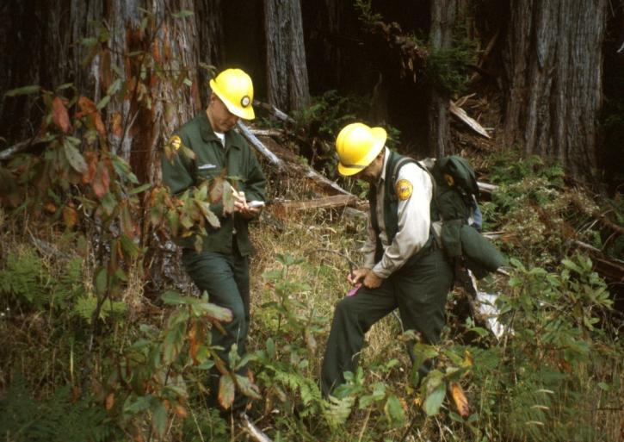
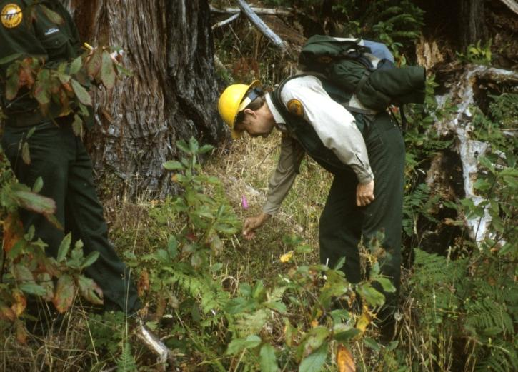
Finally, Make Note of any Special Trail Structures Needed
Notes:
Also- Identify Potential Sources for Native Construction Materials. The end. Now you are ready for the trail construction crew!

Slide 57
Now what? More ways to learn!
More Online Trainings: https://www.pcta.org/volunteer/project-schedule/
Connect With Your Local PCTA Chapter:
https://www.pcta.org/volunteer/regional-groups/
Trail Skills College Curriculum: https://www.pcta.org/volunteer/trail-skills-college/
Look At Trails When Hiking
USFS Publications Website: https://www.fhwa.dot.gov/environment/recreational_trails/publications/fs_publications/

Slide 58
Acknowledgements:
Video by Christophe Haubursin at Vox Media
Some content and images courtesy of Lightly on the Land

